Slide 1

Sensor Programming with using Android Platform
Esra YILMAZ
Ahmet KARA
Advisor: Sibel TARIYAN ÖZYER

Slide 2
Contents
Problem
Analysis
Solution
Results and Conclusion
References
Demo

Slide 3
Problem
We can define robots as automatic machines that are created for the convenience of time and convenience in our work done by people in the simplest terms.
The developed countries in the military field are more powerful. Because of the lack of existing practices, we can stay behind other countries. For this reason, we can support military technology with robots.

Slide 4
Our primary goal is to identify enemies in the military field. And in this sense, we hope that the robots will help us.
We want to Robot control is provided with Bluetooth on Android phones.

Slide 5
Analysis
Robotic technology is very important to identify terrorist attacks in the military area. The lives of military personnel depend on these precautions. The smallest mistake to be made is the loss of life and serious material damage.

Slide 6
Also, we can add more features like Wi-Fi connectivity, robotic arms, camera and different types of sensors such as speed sensor, temperature sensor, PIR sensor, ultrasonic sensor, etc. for this project.

Slide 7

Solution:
Our solution is creating a robot with using Arduino and it can be controlled with Bluetooth.
We will use Integrated Development Environment (IDE) is used for Arduino Uno's comments and messages. Also, we will use Java Development Kit(JDK) for Java application and used Eclipse for writing Java codes.

Slide 8
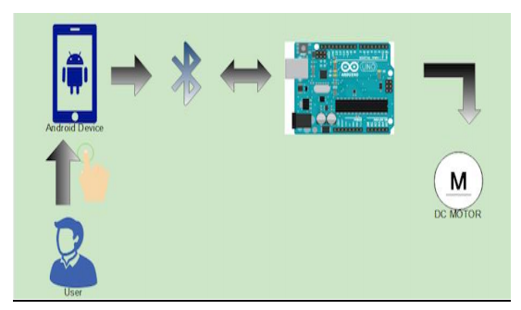
Menu Use Case Diagram for User

Slide 9
Flow Chart

Slide 10
Results and Conclusions
Thanks to Android Sensor Programming:
We aim to implement location tracking and proximity alerts.
Thus, While targets can be destroyed more easily with technological devices, soldier attrition is reduced more.

Slide 11
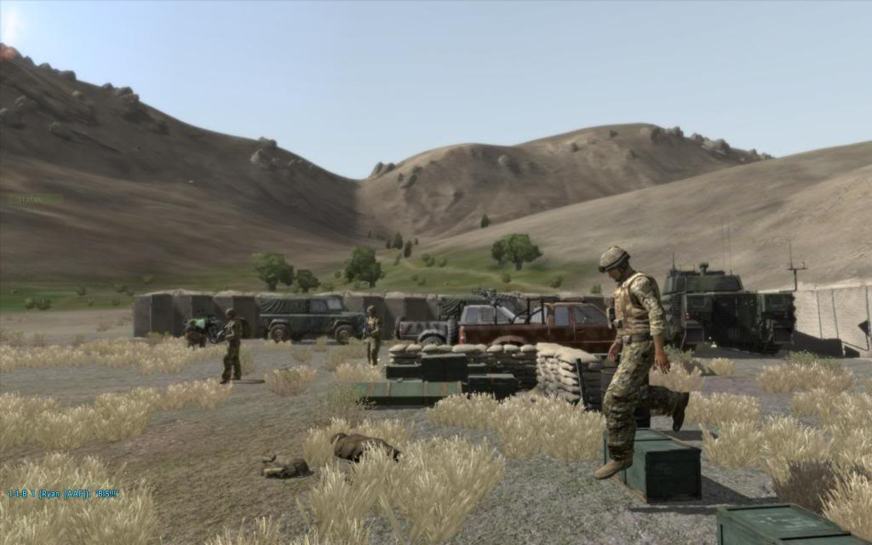
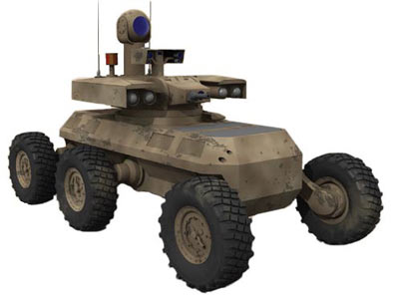
Robot will take precautions against the terrorist attack on the military field.

Slide 12
The user who can control the robot's Android mobile phone will detect the obstacle first and then detect the obstacle and detect the terrorist by means of the obstacle recognizing sensor.

Slide 13
References
Khoje, S., Urad, D., Shirke, M., Robotic Control Using an Android Application, International Journal of Computer Science and Information Technologies, vol 7, no 2, p.773 - 776
Sharma, A., Verma, R., Gupta, S., Android Phone Controlled Robot Using Bluetooth, International Journal of Electronic and Electrical Engineering. , vol 7, no 5, p.443 - 448

Slide 14
Demo
The system consists of four-part. These are such as:
Bluetooth technology
Smartphone with Android operating system,
Microprocessor (Arduino Uno R3)
DC Motor.

Slide 15
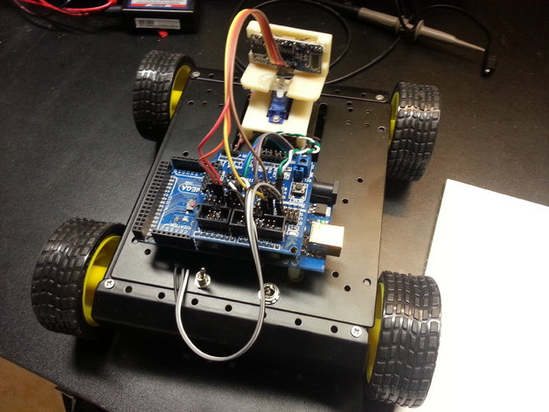
Architecture Design of Project

